Slide 1

Croque Monsieur: Step up Your Toast Notification Game
Josh King
@WindosNZ

Slide 2


Who am I?
Josh King
TechOps Systems Administrator @ Tribe
Microsoft MVP: Cloud and Datacenter Management
 @WindosNZ  ToastIT.dev
@WindosNZ

Slide 3
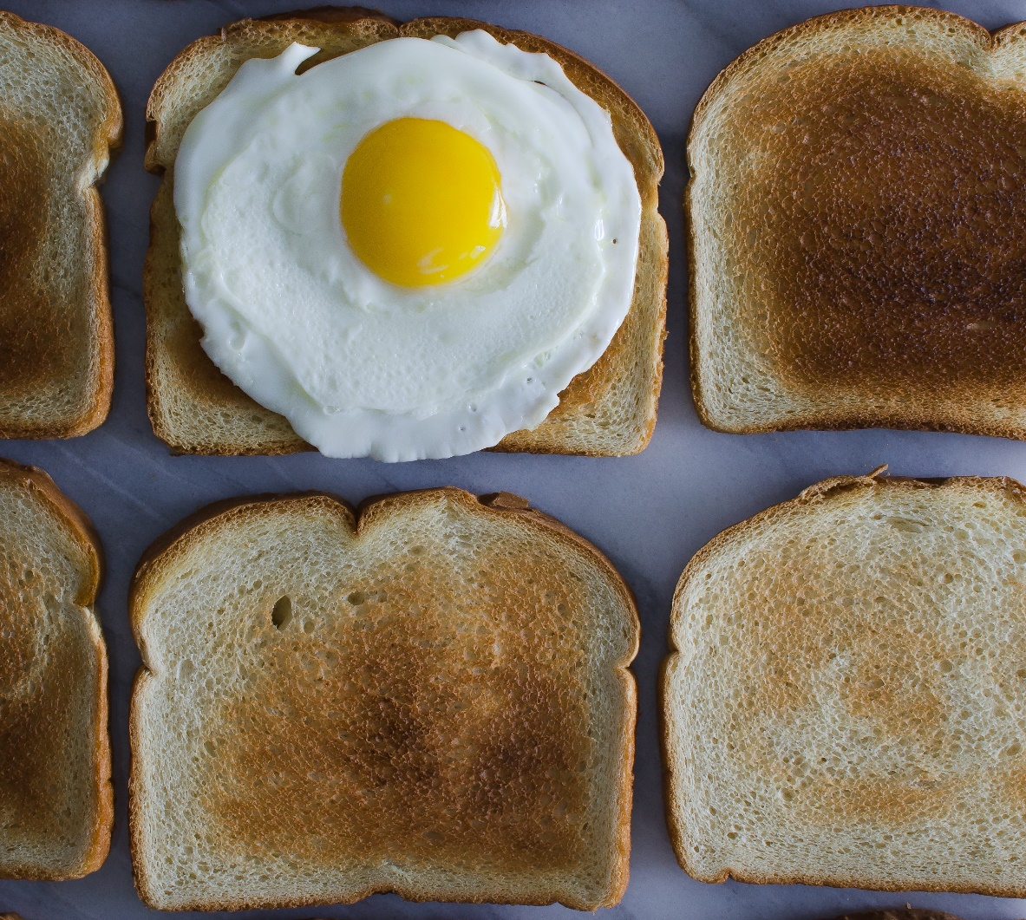
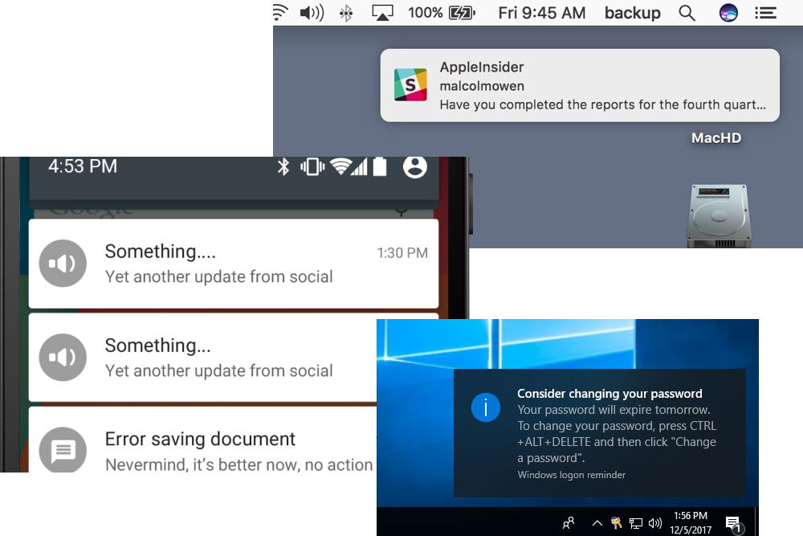
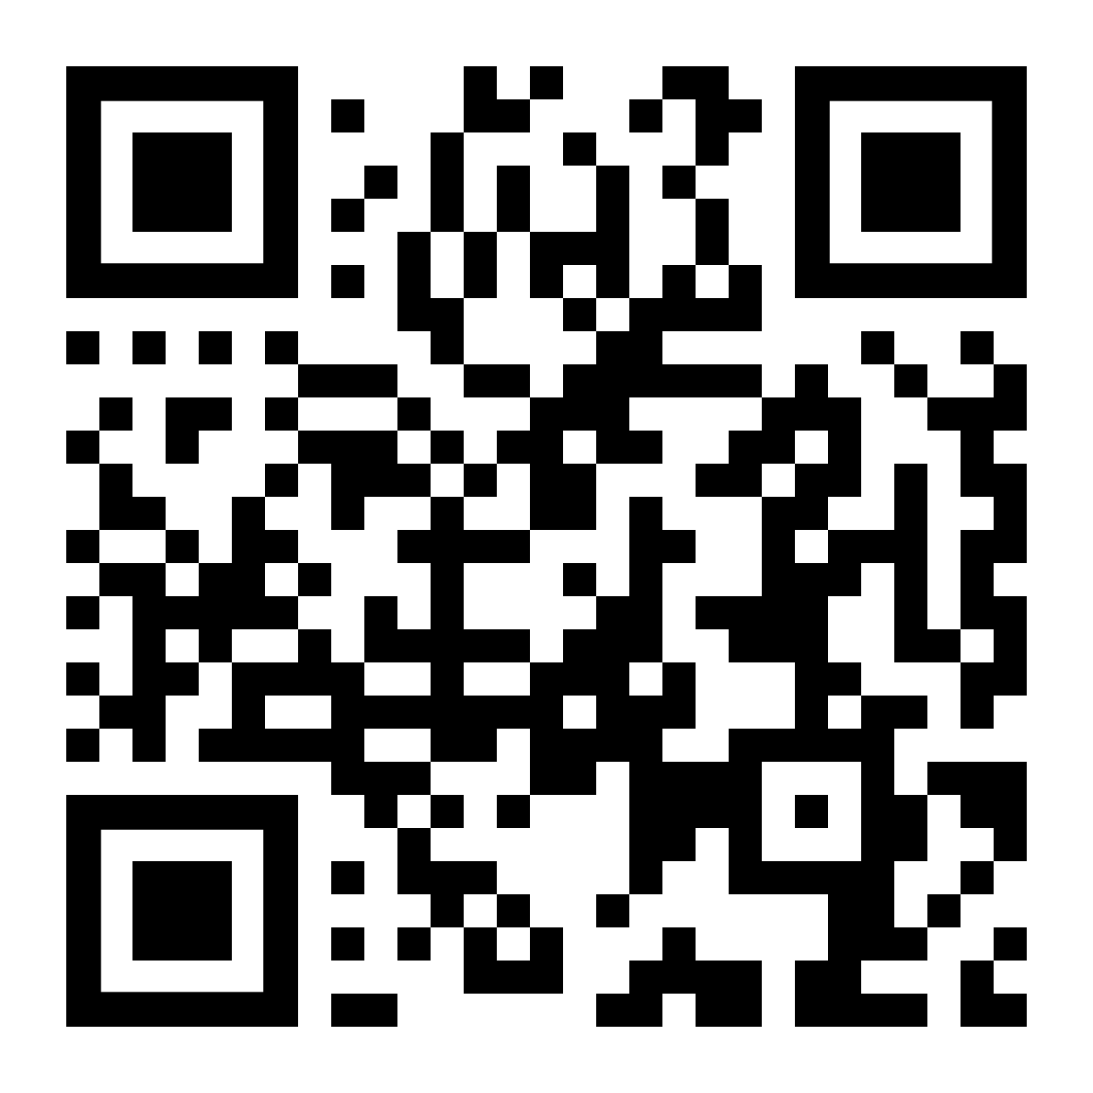
What is Toast?
toast.click/ToastBasics
@WindosNZ

Slide 4


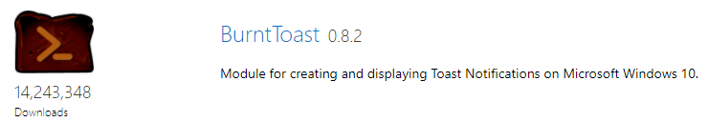
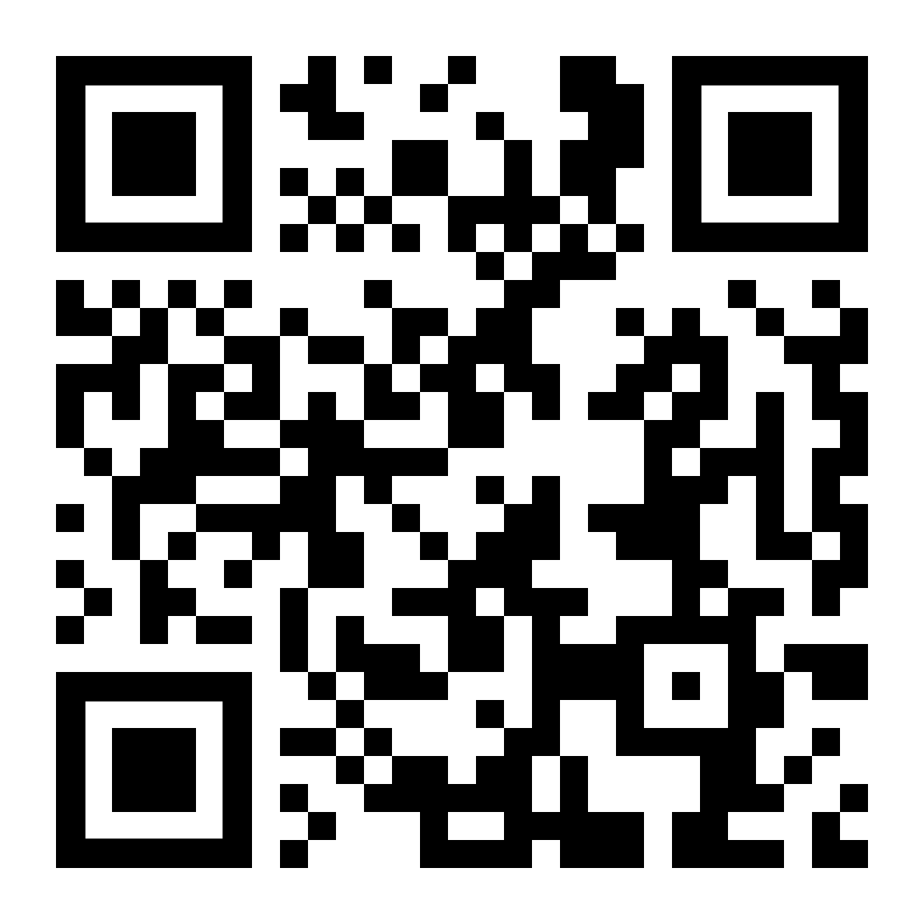
What is BurntToast?
“PowerShell Module for displaying Windows 10 and Windows Server 2019 Toast Notifications”
toast.click/psgallery
@WindosNZ

Slide 5




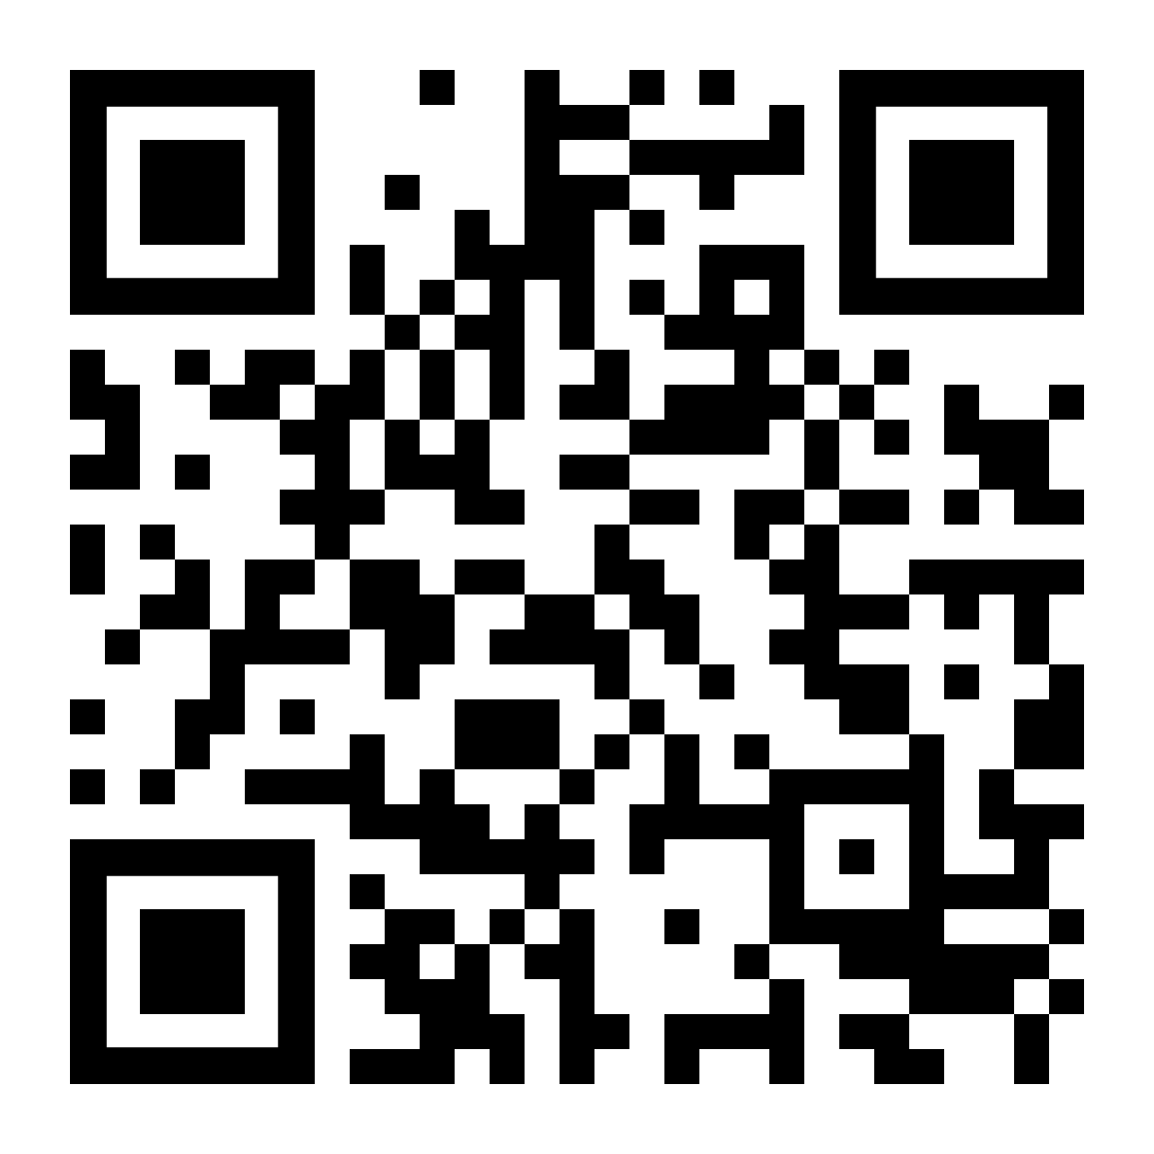
So… Why?
toast.click/NoBurntToast
Icons made by Eucalyp from www.flaticon.com
@WindosNZ

Slide 6
Demo
@WindosNZ

Slide 7
Thank You!
toast.click/Talks
@WindosNZ

